Slide 1
Hudson Valley Building & Construction Trades Council
2021/2022
Prepared for the 2022 Mid-Hudson Valley Construction Industry Mid-Winter Conference

Slide 2
HVBCTC
HVBCTC
OFFICERS
L. Todd Diorio, President
Tony Speziale, Vice President
Sam Fratto, Vice President
Bob Ambrosetti, Treasurer
Mike Gaydos, Recording Secretary

Slide 3
HUDSON VALLEY BUILDING AND CONSTRUCTION TRADES LABOR MANAGEMENT ALLIANCE 451A LITTLE BRITAIN ROAD NEWBURGH, NEW YORK 12550
LABOR TRUSTEES MANAGEMENT TRUSTEES
L. Todd Diorio Alan Seidman
Michael Gaydos John Cooney
Robert Ambrosetti Rob Kaehler
Sam Fratto Jeffrey Lintel
Anthony Speziale Joe Jankowski
Justin Darrow
Lou Doro
Established in April 2015
Maintained Fund Balance of $217,841.93
Active LMA Projects
+ Montreign Golf Course
+ Resorts World Newburgh
+ Greenthumb

Slide 4
Our Strategy Is Unchanged
Inception to Opening
Marketing
Political Activism
Board Positions
Market Recovery
Target Sector Concentration
Warehouse/ Distribution
Hospitals
Renewables
100% Union Contractors (New Concept 22)

Slide 5
Marketing
Website: www.builditunion.org
Username: hudsonvalley
Password: buildingtrades
Brochures
New Warehouse Package
Update PLA
Partnerships
Orange County Partnership
Mid Hudson Pattern for Progress
HVCIP
Contractor Associations – CCA, CIC, NECA, etc
H.V. Building & Construction Labor Management Alliance
Sullivan County Partnership
Coalitions (17 future 86)

Slide 7
Political
Environmental Differences
Climate Leadership & Community Protection Act
No Fossil Fuel Pledge
Leverage Governor
Legislative Priorities
Definition of Public Works
Prevailing Wage
Wage Theft Bill
Street Cutting Bill
Apprenticeship Requirements
PLA’s
Board Appointments
IDA’s
5 MW – 1 MW
Budget Opportunities
NYSDOT
Bringing Projects to the Hudson Valley
Relationships
Fundraisers etc.
School Boards

Slide 8
Impact of Candidate Energy
Are you more or less likely to support a candidate who holds the following positions?
No difference/ not sure
Less likely to support
Net more
likely
More likely to support
Address climate change by moving 100% renewable sources of energy in New York, such as solar, wind, hydro-electric, and geothermal energy.
66%
15%
19%
+ 47
Address climate change by moving 100% non-carbon sources of energy in New York, such as solar, wind, hydro-electric, geothermal, and nuclear energy and promoting carbon capture technology.
57%
18%
25%
+ 32

Slide 9
VALLEY CENTRAL SCHOOL DISTRICT
ADMINISTRATION OFFICES
944 STATE ROUTE 17K
MONTGOMERY, NY 12549-2240
PHONE; (845) 457-240 Ext. 18510
www.vcsd.k12.ny.us
WHEREAS the Board of Education recognizes the need for the continuing development of
Skilled workers in the construction trades and recognizes a need to encourage contractors in said trades to enter into apprenticeship agreements committing them to apprenticeship training programs registered with the New York State Department of Labor in accordance with the provisions of New York State Labor Law §§816 & 816-b;
NOW, THEREFORE, BE IT RESOLVED, THAT FOR THE District construction projects approved by the voters on May 18, 2021 for individual prime construction contracts and construction-related maintenance contracts in excess of $250,000.00, the project bid specifics shall require that contracts with construction trades include requirements that the have existing apprenticeship agreements providing for apprentice training programs registered with the New York State Department of Labor. The District reserves the right to utilize any approved municipal or state contracts for the purpose of the procurement of equipment or services for the above referenced construction projects, consistent with established district procurement policies.
- Kingston IBM

Slide 10
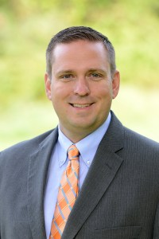
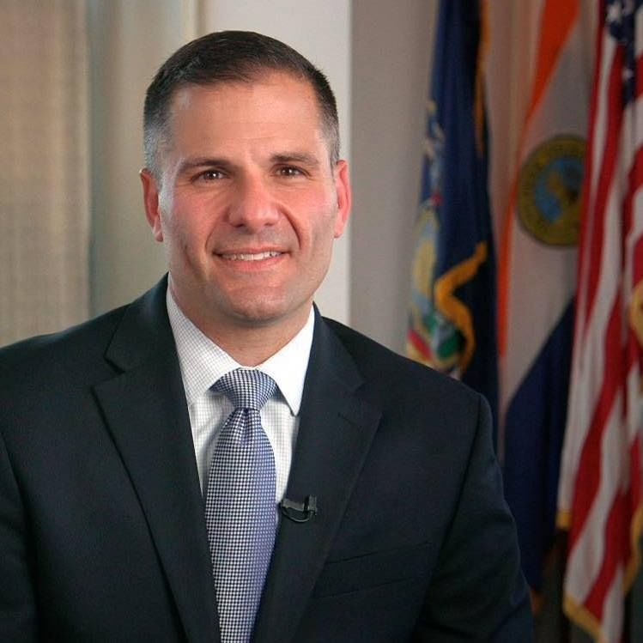
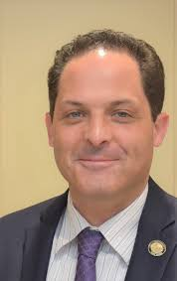
Pat Ryan Ulster County Exec. Steve Neuhaus Orange County Exec. Marc Molinaro Dutchess County Exec. Josh Potosek Sullivan County Manager

Slide 11
Boards
IDA
Ulster County
Mike Hamm (OE)
James Malcolm (Retired Carp)
Note: Labor Policy - PW
Orange County
Mike Gaydos (IW) Dean Tamburri (Laborers’)
Note: Local Labor Policy 85%
Dutchess County
Al Torreggiani
Note: Local Workforce Policy
Sullivan County
Scott Smith (Carp)
Town of Montgomery
John Dickson (IBEW)
Matt Stoddard (IW)
Note: Local Labor Policy 85%
Note: Improvements
Orange County Partnership
Alan Seidman (CCA)
Todd Diorio (HVBCTC)
Jim Smith (Advanced Testing)
Robert Kaehler (Perreca)
Dave Campbell (LeChase)
Dan Depew (Holt)
Ulster County EDC
L. Todd Diorio
S.C. Workforce Development
Chris Cerone

Slide 12
PROJECTS OF SIZE
Upcoming/ Proposed Completed 2021 or Working
Cresco (PLA)
Resurfacing of I-84 Coopers Dam (PLA)
Napanoch WWTP LegoLand (PLA)
Catskill Aqueduct Phase II Marlboro Schools (PLA)
Resorts World Golf Course (PLA) Sailfish (Amazon)
Danskammer (PLA) Thruway Rest Stops
17 Future 86 Red Tail (Amazon)
Glidepath (PLA) NYS Cashless Tolls
NYC-DEP Projects Kingston Traffic Circle
TDI (Lake Champlain Express) (PLA) Stewart Terminal
West Point Projects (*) Vassar Hospital
Dinosaur Park Medline
Warehouses NYC-DEP
Renewables CAT- RR
Newburgh Schools (PLA) Rondout Bypass Tunnel (PLA)
NYSDOT Projects Newburgh Beacon Bridge (PLA)
Various Schools Dutchess County Transition Center (PLA)
Clean Path (PLA) Garnett (ORMC) Parking Garage
Galleria West Point – Building 602, Cyber Building +
Kingstonian Kingston Hospital
Mid Hudson Psych Center (PLA) Bon Secours Hospital – Port Jervis
Garnett Hospital St. Luke’s/ Cornwall Hospitals
SUNY New Paltz (Awosting Hall) Resorts World Newburgh (PLA)
Newburgh Schools (PLA)
County Projects Greenthumb (PLA)
Rt. 28 over Esopus Creek
Matrix Newburgh
LegoLand Phase II
Dutchess BOCES
Napanoch WWTP

Slide 13
WHERE IS OUR OPPORTUNITY IN THE HUDSON VALLEY
CLEAN ENERGY FIELD
Renewables
Battery
E.V.
Wind
TRANSMISSION NY TRANSO
CLEAN PATH
TDI LAKE CHAMPLAIN

Slide 14
INFRASTRUCTURE
Roads, Bridges, Etc.
WAREHOUSES/ DISTRIBUTION
SCHOOL CONSTRUCTION
HOSPITALS
West Point

Slide 15
Laborers’ Local 17
Officers
L. Todd Diorio, Business Manager
Jeffery Diorio, President
Dean Tamburri, Recording Secretary, Secretary Treasurer
Richard Messina, Vice President
Chris Cerone, Executive Board
Mark Casey, Executive Board
Wayne Mackey, Executive Board

Slide 16
Laborers’ International Union of North America Local No. 17 Laborers-Employers Cooperation & Education Trust
Management Trustees Union Trustees
Genaro A. Argenio of Argenio Bros. L. Todd Diorio
Michael Mastropietro of Callanan Industries Jeff Diorio
Justin Darrow of Darlind Associates, Inc. Dean Tamburri
Local 17 Laborers and Union Contractors
Partnering for Safe, Quality Construction, Completed On Time, Within Budget, Using a Skilled, Trained and Productive Local Workforce
845-565-2737

Slide 17
Local 17 Update
Union
2021 Manhours + 1.16 million
10 year average 925,000 manhours
General Fund Growth
Sector Hours
Building Heavy Highway
2015 58% 42%
2016 51% 49%
2017 48% 52%
2018 56% 44%
2019 48% 52%
2020 52% 48%
2021 45% 55%
7 year average 51% 49%

Slide 18
Members Say State and Country on Wrong Track
Do you feel that things in the country are going in the right direction these days, or do you feel that things are pretty seriously off on the wrong track?
Do you feel that things here in New York State are
going in the right direction these days, or do you feel
that things are pretty seriously off on the wrong track?
66%
57%
32%
22%
13%
11%
Right Direction
Wrong Track
Not Sure
Right Direction
Wrong Track
Not Sure
Survey of New York State AFL-CIO Members

Slide 19
Members’ Information Sources
Which do you regularly use as a source for news & information?
53%
33%
27%
12%
11%
One quarter (26%) report listening to podcasts several
Times a week or daily, and another 34% listen less regularly.
Among listeners, 8% have heard “Union Strong.”
Survey of New York State AFL-CIO Members

